Slide 1
VE230 Recitation Class 5
by Li Chunchao
2017/11/2

Slide 2
Short Review

Slide 3

Dielectric
Dielectric
Uniformly polarized dielectric sphere
Gauss law in dielectrics
Boudary condition

Slide 4
Solving Problems

Slide 5
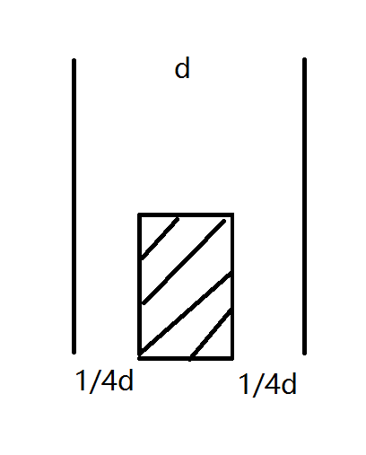
Dielectric
Find the capacity. The surface area is A. The cuboid inside is dielectric with relative permittivity εr. The length of cuboid is half of the plane.

Slide 6
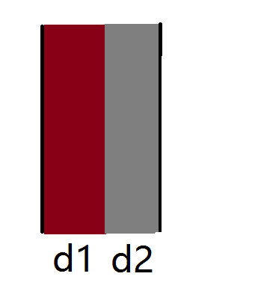
Dielectric
Find the capacity. The surface area is A. The cuboid inside is dielectric with permittivity ε1 and ε2. The length of cuboid is d1 and d2

Slide 7
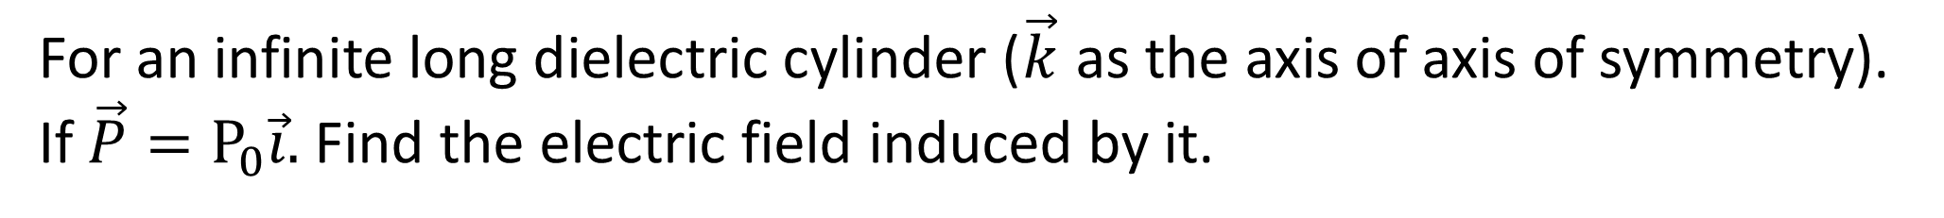
Dielectric
For an infinite long dielectric cylinder ($\vec{k}$ as the axis of axis of symmetry). If $\vec{P}=P_{0}\vec{i}.$ Find the electric field induced by it.

